Slide 1
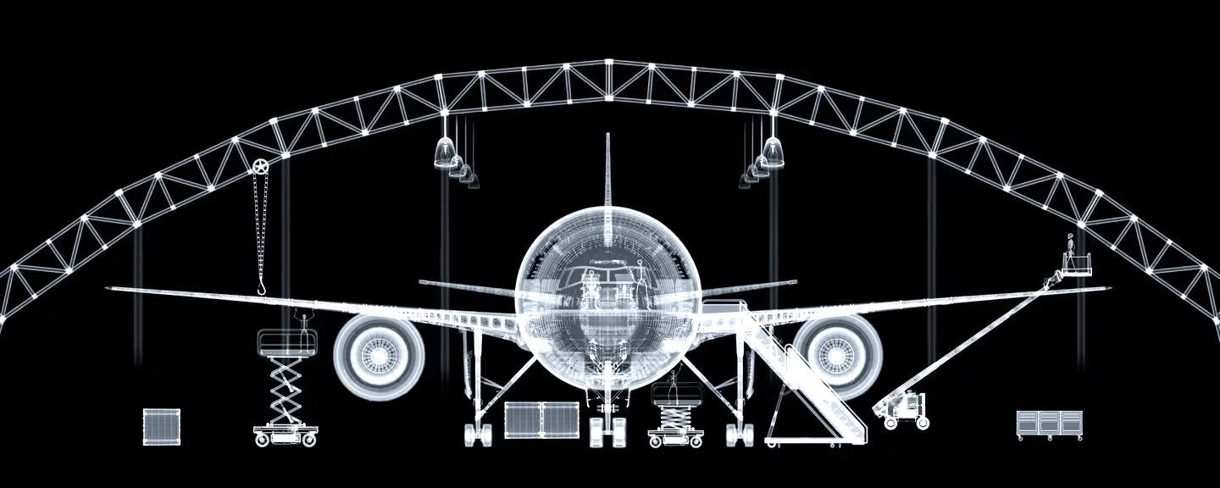


Thriving Skies
AI Modeling for X-Ray Baggage Screenings
Ryan Busman, Elaine Kwan, Deb Peters, Nick Watkins
April 22, 2024

Slide 2

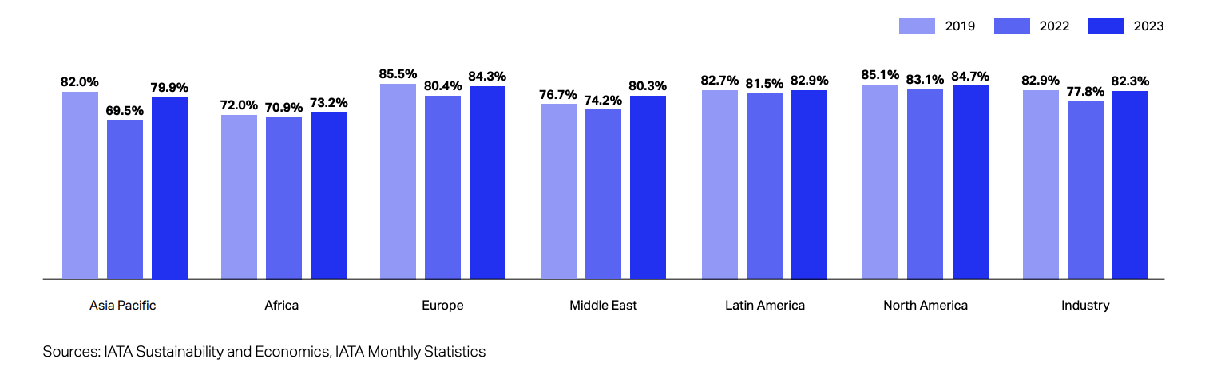
The Aviation
Industry
In 2023, air passenger traffic had
reclaimed its pre-pandemic vigor,
soaring to 94.1% of 2019 levels.
The International Air Transport
Association (IATA) anticipates a
banner year in 2024, with the
global airline passenger industry
poised to achieve record growth.
In 2024…
4.7 billion passengers
$964 billion in revenue
$49.3 billion in operating profit

Slide 3
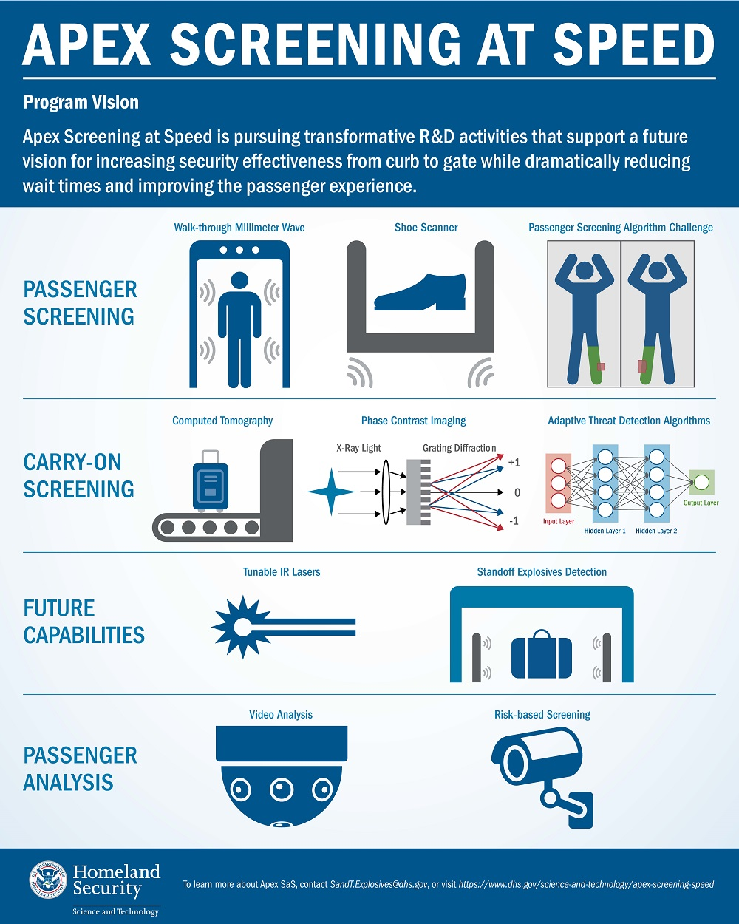

X-Ray Baggage Screening
Transportation security administration
(TSA) personnel screen approximately
2 million passengers a day at 440 US
airports for a total of approximately
3.3 million carry-on bag screenings.
False positives, bag checks, and
manual security measures,
not only disrupt the flow
of passengers but also pose
significant costs and privacy
concerns.

Slide 4
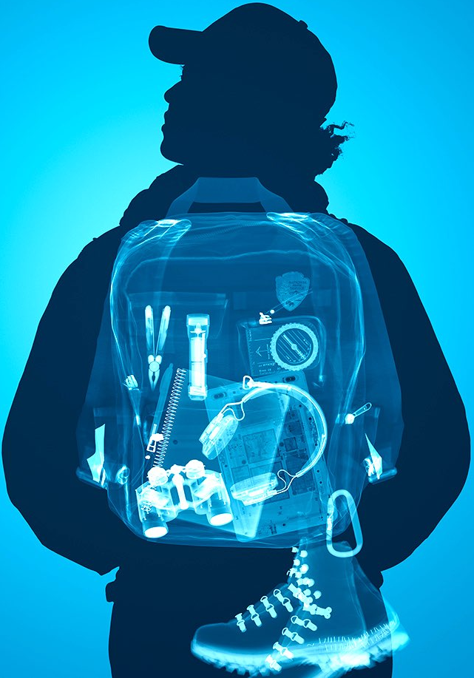
GOALS
1: Improve Accuracy
Improve accuracy of dangerous object
detection in carry-on passenger bags
and for personal objects
2: A Screening Interface
Create a webs-based interactive tool
that can be used to assess the likelihood
of a dangerous object’s presence

Slide 5
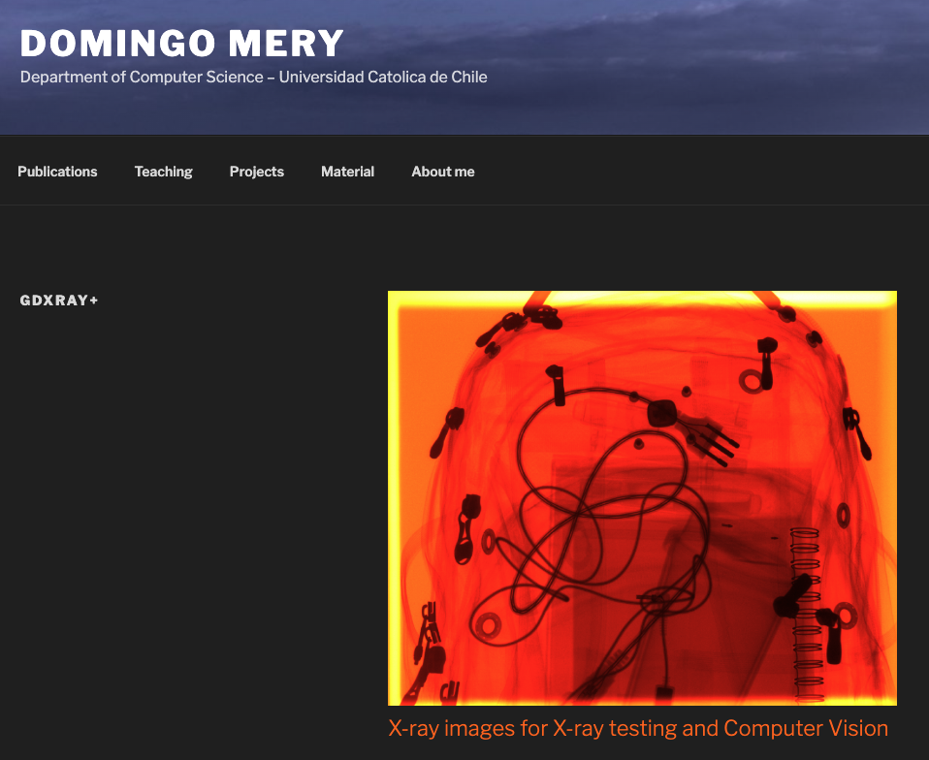
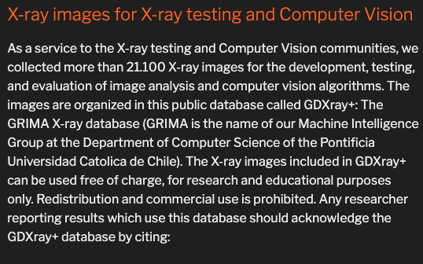
Data Fetching & Preprocessing
GDXRAY+ Dataset: Baggage Subset of 8,150 X-ray images arranged into 77 series
Loaded and inspected the dataset after visually filtering and classifying the images (i.e., several were excluded for being too dark or ambiguous).
We used 3,385 original images from 5 categories objects: benign, gun, knife, razor blade or shuriken (throwing star)
Checked the file path, image sizes, image modes and image format
Images converted to a NumPy Array and stored to an empty list
Resized the images to the standard target size of 224 x 224 pixels
Normalized the pixel values using the PIL library.
Required additional library or technology NOT covered in class was OpenCV library to remove unwanted noise from the images
Images converted to a consistent greyscale using the PIL Library
Augmented the images using the Keras ImageDataGenerator; this generated 10,155 images
All total, the X-trained dataset had 13,540 images.
https://domingomery.ing.puc.cl/material/gdxray/

Slide 6
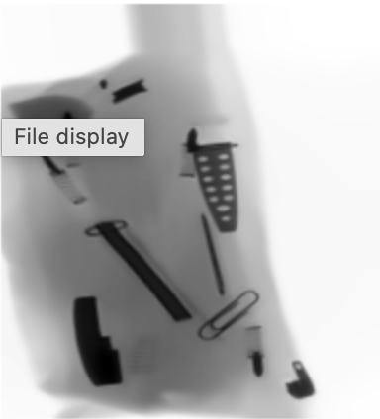
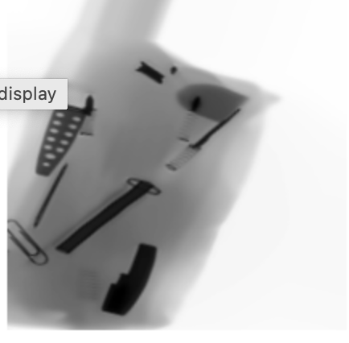
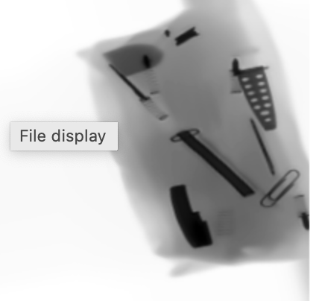
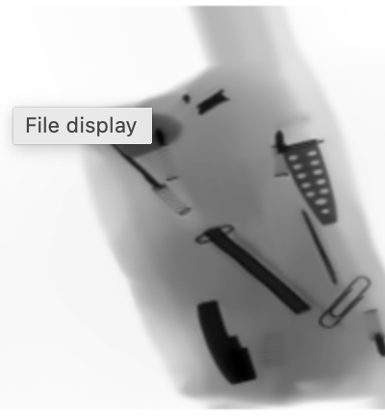
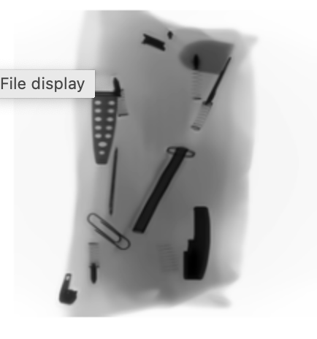
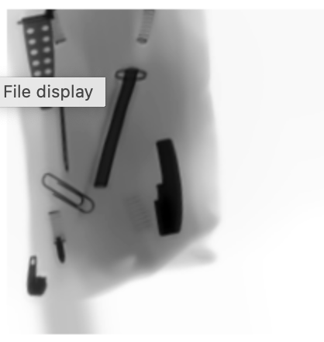
Data Augmentation
Augmentations improve the performance of deep learning models for computer vision tasks such as classification, segmentation, and object detection.

Slide 7
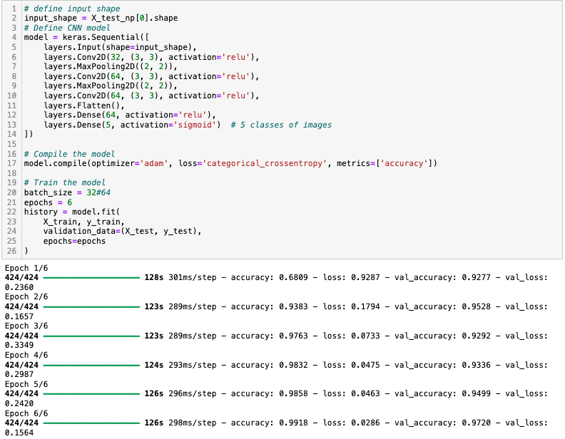
Model Selection and
Architecture
A Convolutional Neural Network (CNN)
The layers are arranged in such a way
so that they detect simpler patterns first
(lines, curves, etc.) and more complex
patterns (faces, objects, etc.)
further along.
Our model had 7 layers: an input
layer, output layer, and 5
hidden layers.

Slide 8

Training and Testing
Hyperparameters
include the:
Number of neurons
Activation functions
Optimizer,
Learning rate
Batch size
Epochs

Slide 9
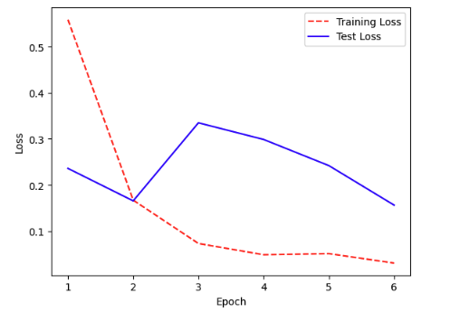
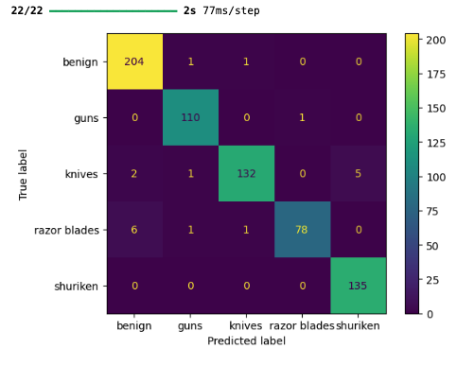
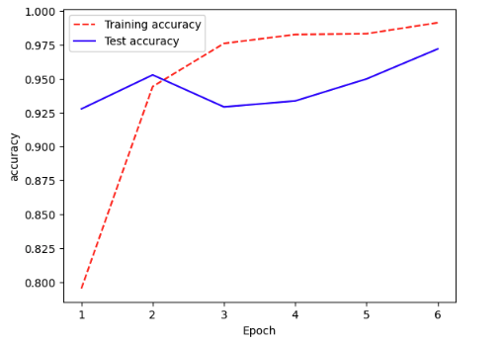
Evaluation and Fine Tuning

Slide 10

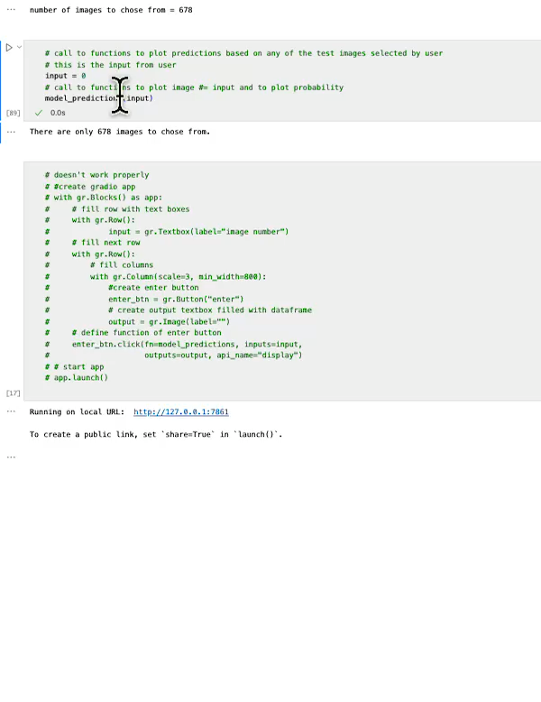
X-Ray Model in Action
User choose from one of 678 test images/data
User inputs an image number
Model predicts if the image is benign, gun, knife, razor blade or shuriken (throwing star)

Slide 11
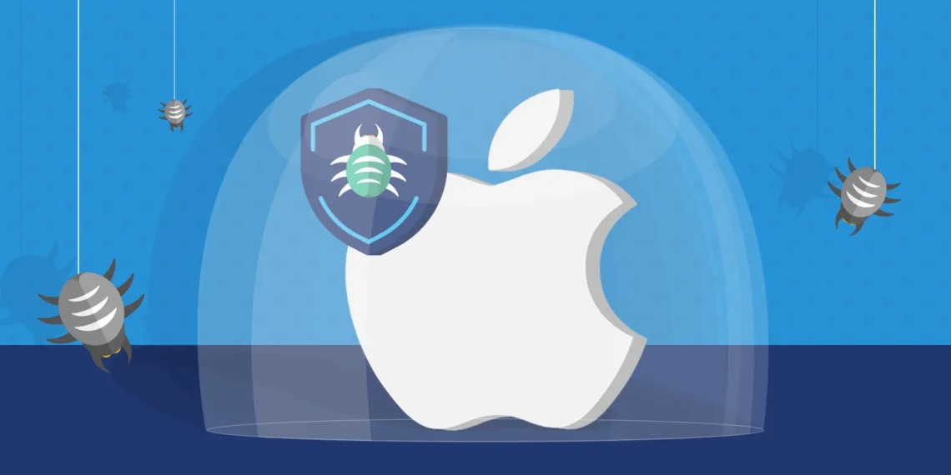
Primary Challenge
Data from trusted sources
The first two datasets had malicious code that targeted the MacBook operating system.
Nick and Ryan had to reset and restore their systems from the data downloaded from Google Drive links in Github repositories.
Caption

Slide 12
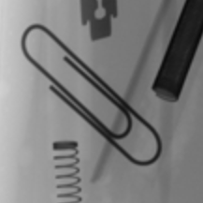
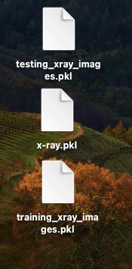
Other Challenges
Sorting the images (Razor, Knife, or Benign?)
Smoothing out of images
Crop or not? Large images take a long time to process versus fuzziness/lower resolution from images that are too small
File size workarounds (Github size; Shuffles with local drives)

Slide 13


The Now…

Slide 14
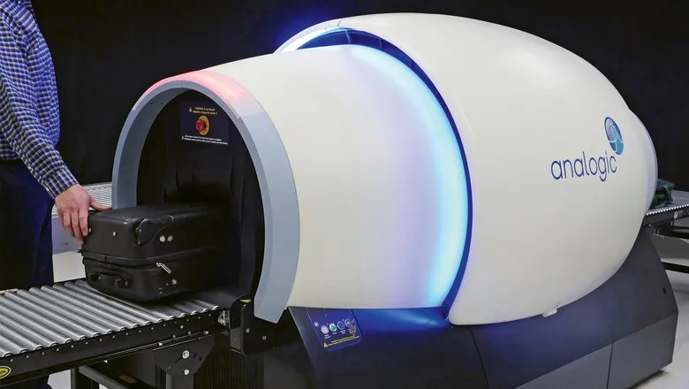
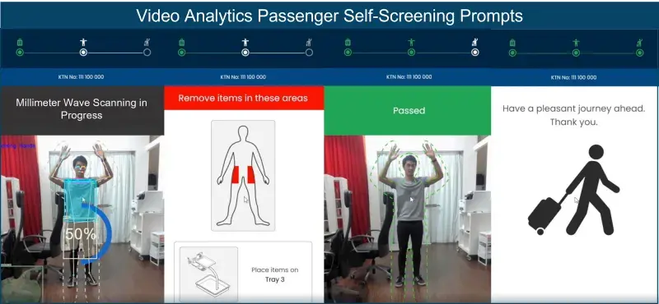
Future Considerations
Usability with Gradio
Scattered X-Rays for material composition
3D CT images
Bio-sensing
Prompts for self-screening lanes
Voxel Radar: In-motion panel sensors

Slide 15
Thank You!
The Project X-Ray Team

